Slide 1
BSA New Renewal System Overview
January 11, 2024

Slide 2
Welcome and Introductions
The New Membership and Unit Renewal Task Force has been charged with the responsibility to develop a communication plan, clear guidelines for councils and units, and to create the tools and resources for all applicable BSA stakeholders. The goal is to keep it simple and to be a resource to support local councils with this new business model.
National Staff, CST and Council Volunteers, Director of Field Services/Deputy SE’s and Scout Executives
Objective Today
High level overview of the process
Presenters
Chris Crowley, Deputy Scout Executive – CFC (Orlando, FL)
Clint Scharff, Council Service Territory 16 Director
Michael Creagh, National - Manager, Member Applications
A Few Reminders…
FAQ’s update
Submit questions in Q&A
Is this recorded? Yes.
Introduction…
Ron Timmons, National Director of Council Services
Otto Goedhart, National – Manager, Membership Growth

Slide 3
2024 Membership Goals and Plans
By February 15th - Monthly Membership Goals, Spring New Youth and Fall New Youth Projections Due. Membership Goals include the following core programs – Cub Scouting, Scouts BSA, Venturing/Sea Scouts and Exploring. (My.Scouting |Council Membership Tools – Membership Projections)
By March 29th – Council Board Approved Membership Plans Due
(2024 Council Membership Plan)
2024 Council and District Growth Plan Workbook
(2024 Council Membership Plan)
Chris Crowley, Deputy Scout Executive – CFC (Orlando, FL)

Slide 4
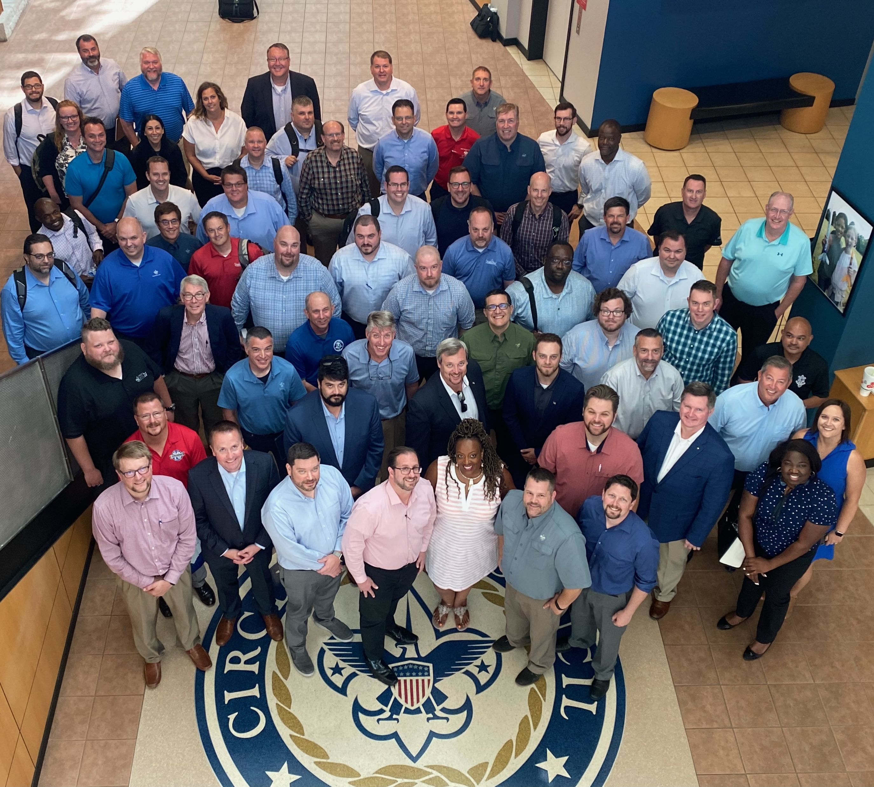
2024 Monthly Rally Dates 3rd Thursday of Every Month
February 15, 2024
March 7-8, 2024 (In-person)
April 18
May 5-9 (NAM, In-person)
June 20
July 18
August 15
September 19
October 17
November 21

Slide 5
Communications Plan
Multi-channel communication strategy- CST newsletters, Commissioner platforms, BSA communication channels, BSA wire, Workplace, SE weekly packet, social media, direct email.
1st ¼ 2024- Focus on BSA staff (registrars and field staff), NST Volunteers, and Commissioners current charter process and create awareness and training for new process
2nd ¼ 2024- volunteer focused message- What & How
3rd ¼ 2024- focus on member renewal- Volunteers and members
4th ¼ 2024-focus on member & unit renewal
1st ¼ 2025- focus on member & unit renewal
Clint Scharff, Council Service Territory 16 Director

Slide 6
Auto Renew Membership
Timeline
Unit Renewals
Parent view
Unit View
Council View
Micheal Creagh
Manager, Member Applications

Slide 7
Auto Renewal Membership – March Unit Renewals

Slide 8
Auto Renewal Membership – March Unit Renewals

Slide 9
Unit Recharter BEFORE March 1, 2024
>> NO CHANGES <<
Unit Renewal AFTER March 1, 2024
>> Auto-Renewal Process <<
Youth and adult leader membership fees will be separated from the unit charter.
Login at https://advancements.scouting.org/
Unit Leader, Unit committee chair, chartered organization representative, or designee
Auto-Renewal
Manual Renewal
Unit Paid Renewals
Auto-Renewal
Individual membership renewal and fees are paid automatically by the individual
Manual Renewal
Individual membership renewal and fees are paid to the unit or local council office.
Unit Paid Renewals
Individual membership renewal and fees are paid by the unit
Click on re-charter located on the lower right menu.
Enter 12-month term
Login at My.Scouting.org and go to Organization Manager (Unit Leader, committee chair, chartered organization representative, or designee have access)
Edit Roster
Click on “Unit Renewal "on the menu.
Invite New Members
Update Adult Leader Positions
Remove Members
Validate Information
Make changes to Leadership if needed in Position Manager – Have leaders take YPT if needed
Validate Information
E-Sign the Page
Pay and Submit
Pay and Submit

Slide 10
Auto Renewal Membership – Unit Renewals

Slide 11
Auto Renewal Membership – Unit Renewals

Slide 12
Auto-Renewal Membership
For all youth and adult members of the BSA
Note: All registrations are for 12 months. For example, if your current registration expires on 12/31/2023, your renewed membership will start on 1/1/2024 and run through the entire calendar year until 12/31/2024. Membership renewal can be completed by either the individual, the family or the unit.
Auto Renewal Membership Family/Self Pay
Auto Renewal Membership Unit Pay
An email notification and a renewal link will be sent 60 days before membership expires.
The link provided in the email will direct individuals to a renewal form on My.Scouting
If registered in multiple positions, select the primary position. Renewing the primary position will automatically renew multiple positions.
The individual pays with a credit card and submits the renewal.
The unit will approve the membership renewal.
In Organization Manager, the unit selects the Unit Pay option.
Unit Key 3s are notified each month about which members are due to renew that month.
Using the Roster tab, the unit selects which members they are renewing.
The unit can choose not to renew a member (opt-out). The unit can also change the Scout’s Life subscription settings for each person.
The unit pays with a credit card or establishes a securely stored electronic fund transfer payment (ACH) and submits the renewal.

Slide 13
Auto Renewal Membership

Slide 14
Auto Renewal Membership
For all Youth and Adult members in the BSA
All Membership Terms are for 12 months
New Membership Renewal will only have a one-month lapse
New Unit Renewal will only have a one-month lapse
Parent/Guardian e-mails are needed
Parents can Opt-Out and Units can Opt-out the member too
A one-time data sync will be done in March to align all Multiple and Functional Registrations to the Primary (paid) expiry date

Slide 15
Auto Renewal Membership – Family / Self Pay

Slide 16
Auto Renewal Membership – Family / Self Pay

Slide 17
Auto Renewal Membership – Family / Self Pay

Slide 18
Auto Renewal Membership – Family / Self Pay

Slide 19
Auto Renewal Membership – Family / Self Pay

Slide 20
Auto Renewal Membership – Unit Pay

Slide 21
Auto Renewal Membership – Unit Pay

Slide 22
Auto Renewal Membership – Unit Pay

Slide 23
Auto Renewal Membership – Unit Pay

Slide 24
Auto Renewal Membership – Unit Pay

Slide 25
Auto Renewal Membership – Unit Pay

Slide 26
Auto Renewal Membership – Unit Pay

Slide 27
Auto Renewal Membership – Pay at the Council Office

Slide 28
Auto Renewal Membership – Missing Parent Guardian Relationship

Slide 29
Auto Renewal Membership – Missing Email Address Report

Slide 30
Auto Renewal Membership – Unit Roster Report

Slide 31
Auto Renewal Membership – Member without Unit Report

Slide 32
Thank You for your attention, and for everything you do for Scouting!

